Slide 1
Managing Information System

Slide 2
Characteristics of IS
Timeliness
Accuracy
Consistency
Completeness
Relevance

Slide 3
Managing Information System
Managing an IS within an organization required organizational change
The introduction of an IS much more than mere introduction of New hardware and software
It involves changes in jobs, skills, management, etc..
Whenever a new IS is being introduced in organization the entire organization need to be redesigned around the IS.
Hence it is necessary that the IS manager understand how the new system will affect specific organizational process and the organization as whole.

Slide 4
IS and Organizational Change
The introduction of IS system ensure organizational change which may be vary from smaller to larger changes.
These changes are categorized are:
Automation
the first and most evident form of organizational change is the automation that is an outcome of the introduction of the new IS.
The new IS assist employee in performing their tasks more efficiently & effectively.

Slide 5
IS and Organizational Change
Examples of automation:
- Computerized stocks/inventory/material checking
- Rail reservation system
Business Process Redesign
The more powerful organizational change is business process redesign in which the existing business processes are analyzed, simplified and redesigned.
The redesign of business process result in organization of workflow, elimination of unnecessary and repetitive steps, restructuring of some jobs made redundant by new system

Slide 6
IS and Organizational Change
It is proved that business process redesign brings changes inn functionality of organization.
Example – IS in banking sector
Rationalization of procedure
Next effect of IS on the various procedure that run within organization.
Automation automatically induce (produce, generate or motivate) rationalization of procedure
Rationalization is the reorganization of a company in order to increase it’s operating efficiency.

Slide 7
IS and Organizational Change
This sort of reorganization may lead to an expansion or reduction in company size, a change of policy or rules or alteration of strategy pertaining to particular products offered.

Slide 8
What is Business
An organization or enterprise engaged in commercial, industrial and professional activities.
Business is an economic activity, which is related with continuous and regular production and distribution of goods and services for satisfying human wants.

Slide 9
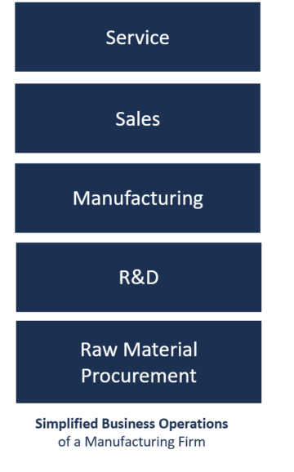
Operations in Business
Everything that happens with the company to
keep it running and earning money is referred
to collectively as business operations.
Operating activities: relate directly to the
business providing its goods to the market
including manufacturing, distributing,
marketing and selling. They provide most of
the company’s cash flow and hugely influence
it’s profitability.

Slide 10
Managing Information System
First Order
Second order
Third Order Effects

Slide 11
Centralization vs. Decentralization

